Slide 1
Welcome to the 2023-2024 Title I Annual Parent Meeting
Sunset Park Elementary
August 30th, 2023
6:00 pm
Cafeteria
Wendy Hernandez
Notes:
Note: This presentation may be utilized for virtual and/or in person meetings. All schools are required to update the presentation with the school’s information (see highlighted sections on each slide). Suggested meeting duration is one hour and separate from Open House.
Ensure Title I Annual Parent Meeting sign in sheet is available for all participants.
Schools are encouraged to insert pictures/graphics/videos into their presentation.
Families should be encouraged to provide input and feedback throughout the meeting.
The purpose of this presentation is to provide required Title I information with parents and families as well as fully engage them with the presentation.
To engage the audience, the presenter may provide opportunities for participants to answer slide title questions, read slide information, ask questions, respond to questions, and share.
Other ideas to engage the audience; have students assist with the presentation, have a post-it note board for questions, have audience use technology (Phones, laptops, computer lab setting, iPad etc.) to follow along and use live links included in the presentation, take photos during the presentation and post, use links as virtual field trips and scavenger hunts to find information, use technology for participation during the presentation (examples: Kahoot, Mentimeter, Quizlet)
Please designate someone to take meeting minutes that follow the presentation topics and that can later be made available to parents/families and is kept in the Title I Compliance filing system.

Slide 2
What topics will you learn about today?
AGENDA
All About Title I
Title I Schoolwide Funds
Title I District-level Parent and Family Engagement Plan (PFEP)
Title I School-level PFEP
School Improvement Process (SIP)
School Achievement and Performance Data
Curriculum, Instruction & Assessment
Title I School-Parent Compact
2
Notes:
Note: Slide #1, #2, and #3 (2 slides per page) should be printed and placed in folder VI.3 with the meeting flyer in multiple languages, with the access and accommodations disclaimer, and the attendance records (in corresponding month) of the Title I School-level Compliance Filing system.
To engage participants - Ask the title question and have participants read bullets.

Slide 3
What topics will you learn about today?
AGENDA
School Improvement Process (SIP)
School-Parent Compact
Parents, Families, and Schools Working Together
Parent’s Right-to-Know
Coordination with Other Federal Programs
School-level Parent and Family Engagement Survey
Consultation and Complaint Procedures
School Contact Information
3
Notes:
Note: Slide #3 is a continuation of slide #2
Note: Slide #1, #2, and #3 (2 slides per page) should be printed and placed in folder VI.3 with the meeting flyer in multiple languages, the disclaimer, and attendance records (in corresponding month) of the Title I School-level Compliance Filing system.
To engage participants - Ask the title question and have participants read bullets.

Slide 4
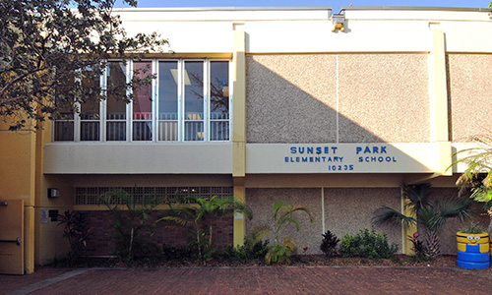
What is the Purpose of this Meeting?
All About Title I
Federal guidelines require Title I schools to hold a Title I Annual Parent Meeting to explain and discuss the Title I Schoolwide Program requirements.
Sunset Park Elementary is a Title I School.
4
Notes:
Slide 4 and 5 go together
If possible, include a welcome message on your website and marquee for students, parents & families. You may also include a slide showing the school marquee message.

Slide 5
WHAT IS THE PURPOSE OF THIS MEETING?
All About Title I
Title I is the largest federally funded education program under the
Every Student Succeeds Act (ESSA)
It is designed to provide students with additional help in Reading, Language Arts, Mathematics, Science and Social Studies.
Its main objective is to support schools and districts in order to ensure that high quality education is equitable for all students.
The Title I Schoolwide Program is committed to helping schools close the achievement gap between disadvantaged and minority students and their peers.
To learn more, please visit http://title1.dadeschools.net. This website is designed to supply visitors with information relevant to Title I and to provide a clear understanding of the overall program.
5
Notes:
To engage participants – Allow participants to provide input/enter comments/questions. Use this opportunity to ask questions (example, How many of you have heard of the Every Student Succeeds Act EESA? Yes/No, Does anyone know when it was signed into law? 2010).
To engage participants- Have participants use link to visit the Title I website.

Slide 6
How DOES The Every Student Succeeds Act (ESSA) and the Title I Parent and Family Engagement Requirements help parents and families?
All About Title I
The school district and all Title I schools must allocate a portion of their Title I budget towards programs, activities, and procedures for parent and family engagement.
The school district and all Title I schools must develop with, and distribute to parents and family members a written Title I Parent and Family Engagement Plan (PFEP).
All Title I schools are required to collaborate with parents and families in the development of the School Improvement Process (SIP) and School-Parent Compact.
www.sunsetparkelementary.com
6
Notes:
Inform meeting participants that the 2022-2023 Title I School-level PFEP, District-level PFEP, SIP, and School Parent Compact will be located on the school’s website, the PRC/Area and the main office.
To engage participants – Have participants read the bullet points from the slide.
To engage participants – Use link to navigate school website and view documents.
To engage participants – Ask the title question and allow the opportunity for parents/families to share their comments. Read aloud some of the responses.

Slide 7
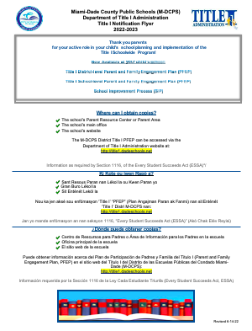
Where can you access title I Compliance Documents?
All About Title I
7
Notes:
Inform meeting participants of the availability of the Title I Parent Notification Flyer posted on the school’s website. The PRC/Area. Main Office, and at title1.dadeschools.net. Provide directions for accessing the flyer.

Slide 8
How is title I funding provided for your child’s school?
Title I Schoolwide Funds
A portion of the Title I Schoolwide Funds are used to fulfill the parent and family engagement requirements in the ESSA law and provide supplemental materials and resources. The Educational Excellence School Advisory Council (EESAC) is the official forum to discuss the details of Title I funding.
Schoolwide Funds
Amount of funds available
for this school year: $ 118,789
Title I Parent and Family Engagement Funds
Amount of funds available
for this school year: $ 20,291
8
Notes:
Inform meeting participants that they may view additional information and guidelines on how Title I funds are to be utilized in the Title I Handbook located on the Title I website under School-level Compliance. Provide the calendar/schedule of EESAC meetings participants and invite them to attend.
To engage participants – Ask for input regarding how to best allocate the school’s available Title I funds (share how the funds were used the previous year) allow participants an opportunity to respond. Read aloud some of the responses. Ensure the responses are recorded in the meeting minutes.

Slide 9
What is the Title I District-level PFEP?
Title I District-Level PFEP
The Title I District-level PFEP is a blueprint of how the District Local Educational Agency (LEA) and Title I schools will work together with parents and family members to establish expectations for family engagement and strengthen student academic achievement.
The Title I District-level PFEP describes how the District will:
provide the coordination, technical assistance, and other support actions to assist schools in planning and implementing effective parent and family engagement activities, and
conduct, with meaningful involvement of parents and family members, an annual evaluation of the content and effectiveness of the parent and family engagement plan towards improving the academic quality of all schools served under Title I, Part A.
9
Notes:
Schools may include a link to the Title I District-level PFEP on this slide and provide directions for accessing it on the school’s website.
To engage participants – Ask where can the District-level PFEP be located? (Title I web site, school web site, PRC/Area, and the main office)

Slide 10
What is Our Title I School-level PFEP?
Title I School-level PFEP
The School-level PFEP is a blueprint of how Sunset Park Elementary will work together with parents, family members, and the community to establish expectations for family engagement and strengthen student academic achievement.
10
Notes:
Note: slides #10, #11, #12 #13 go together
Ensure the topic, Title I School-level PFEP is recorded in the meeting minutes.
To engage participants - Allow meeting participants to provide feedback on the information presented. Ask if there are any questions/feedback.
To engage participants - Provide an opportunity for meeting participants to share how they prefer to receive information from the school.

Slide 11
What is Our Title I School-level PFEP?
Title I School-level PFEP
Our School-level PFEP describes how our school will:
Convene an annual meeting to inform parents and family members of their rights to be involved in the Title I program; PTA, The Parent Academy and the school’s parent resource center.
Offer meetings at flexible times to maximize participation;
Provide parents and family members with timely information about Title I programs; Schoology, Class Dojo, flyers in backpack, SPE Website, Social Media, and in Parent Resource Center areas.
11
Notes:
Note: slides #10, #11, #12, and #13 go together
Ensure the topic, Title I School-level PFEP is recorded in the meeting minutes.
At this time you may provide the opportunity for the ESSAC Chairperson to greet meeting participants and invite them to the next ESSAC Meeting. EESAC representative should inform meeting participants how they may access the EESAC calendar for upcoming meetings and provide information/directions for virtual meetings, as applicable.

Slide 12
What is Our Title I School-level PFEP?
Title I School-level PFEP
Our School-level PFEP describes how our school will:
Involve parents, in an organized, ongoing, and timely manner, in the planning, reviewing, and improvement of schoolwide activities and involve parents and families in the planning, reviewing, and improvement of documents required by the Title I Program such as: the Title I School-level PFEP, the School-Parent Compact, and the joint development of the Title I schoolwide program plan (School Improvement Process [SIP]) and EESAC committee monthly meetings.
12
Notes:
Note: slides #10, #11, #12, and #13 go together
Ensure the topic, Title I School-level PFEP is recorded in the meeting minutes.
You may ask for the ESSAC Chairperson to greet meeting participants and invite them to the next ESSAC Meeting. EESAC representative should inform meeting participants how they may access the EESAC calendar for upcoming meetings and provide information/directions for virtual meetings, as applicable.

Slide 13
What is Our Title I School-level PFEP?
Title I School-level PFEP
Our School-level PFEP describes how our school will:
Assist parents and families in understanding academic content standards, assessments, and how to monitor and improve the academic achievement of their children; and provide ongoing communication with teachers and Community Involvement Specialist for additional resources.
Provide training to assist parents and families of students enrolled in schools implementing the Title I Schoolwide Program to improve their child’s academic achievement.
13
Notes:
Note: slides #10, #11, #12, and #13 go together
Ensure the topic, Title I School-level PFEP is recorded in the meeting minutes.
To engage participants - Schools may share the new platform Schoology iStation, with meeting participants . You may take this opportunity to survey meeting participants to inquire if they have assisted their children with utilizing this platform.

Slide 14
What is Our School Improvement Process (SIP)?
The School Improvement Process
Our School’s Mission Statement
Sunset Park Elementary School is committed to the pursuit of excellence seeking to maximize each student’s academic, social and patriotic potential enabling them to become lifelong learners and productive citizens.
14
Notes:
Note: Slides #14, #15, #16 and #17 go together
Remind meeting participants where they can view the SIP.

Slide 15
What is Our School Improvement Process (SIP)?
The School Improvement Process
Our School’s Goal for 2023-2024
ELA: From 64% to 70%
Math: From 68% to 70%
Science: From 58% to 65%
15
Notes:
Note: Slides #14, #15, #16 and #17 go together

Slide 16
How Do we use Our School Achievement Data?
School Achievement and Performance Data
Our school uses data to align the curriculum to State and District academic standards.
Our instructional practices are adjusted based on the findings of the assessment data.
For further details about our school achievement data, we invite you to attend the EESAC meetings throughout the school year.
16
Notes:
Note: Slides #14, #15, #16 and #17 go together
To engage participants - Allow the opportunity for meeting participants to provide input/feedback. You may ask questions based on the information discussed.

Slide 17
How Do we use Our School Achievement Data?
School Achievement and Performance Data
Our school uses data to align the curriculum to State and District academic standards.
Our instructional practices are adjusted based on the findings of the assessment data.
For further details about our school achievement data, we invite you to attend the EESAC meetings throughout the school year.
17
Notes:
Note: Slides #14, #15, #16 and #17 go together
To engage participants - Allow the opportunity for meeting participants to provide input/feedback. You may ask questions based on the information discussed.

Slide 18
What is the School-Parent Compact?
The School-Parent Compact
Each Title I school must have a School-Parent Compact that is developed jointly by parents and school personnel.
The compact sets out the responsibilities of the students, parents, and school staff in striving to raise student academic achievement.
At the elementary grades (K- 5 only), the compact will be discussed and amended during parent-teacher conferences and documented in a teacher communication log.
18
Notes:
To engage participants – Access the School-Parent Compact using the link and review/discuss the School-Parent Compact with participants and allow time for feedback/comments.

Slide 19
What does School and Parent Collaboration look like?
Parents, Families, and Schools Working Together
Our school offers workshops, trainings, and parent/teacher conferences at flexible meeting times Monday through Friday after school and in the evenings and a Parent Resource Center/Area;
School and parent partnerships are built within advisory councils such as the Educational Excellence School Advisory Council (EESAC), the Title I District Advisory Council (DAC), and the South Region Parent Advisory Council (PAC);
Title I DAC and Region PAC members are representatives of parents who consult with the District Title I DAC on the planning and implementation of the Title I Schoolwide Program.
19
Notes:
Note: Slides #19 and #20 go together.
To engage participants – Survey parents regarding their input on how to best collaborate with the school.
Inform meeting participants of the method the school will utilize to inform parents/families of upcoming meetings, etc. Describe how meeting notices/invites (including virtual meetings) will be sent/made available to parents/families. Describe how the school will keep all parents informed, specifically parents who may be unable to attend virtual/in person meetings (ex. archived virtual meetings).

Slide 20
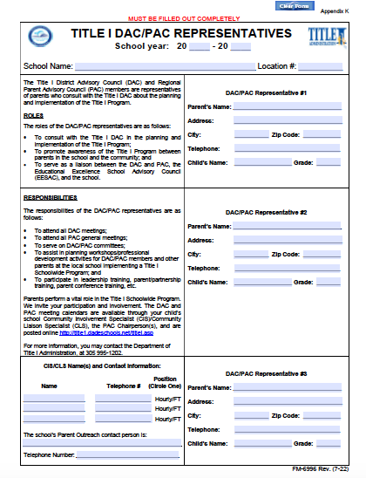
What does School and Parent Collaboration look like?
Parents, Families, and Schools Working Together
The school conducts elections for Title I DAC/PAC Representatives.
20
Notes:
Note: Slides #19 and #20 go together.
To engage participants – Open the floor for nominations to service as DAC/PAC Representatives for your school.
Inform meeting participants that the Title I District Advisory Council and Parent Advisory Council Meetings will be conducted virtually. Additional information regarding the Title I DAC and PAC meetings will be forthcoming. Encourage meeting participants to visit the Title I Website for additional information regarding the Title I DAC and PAC.

Slide 21
What is the Parent’s Right-to-Know?
Parent’s Right-To-Know
Parents have the right to request and receive timely information regarding the professional qualifications of their child’s teachers and paraprofessionals.
Parents must be notified if their child is assigned to, or taught, by a teacher who does not meet state certification requirements for the grade level or subject area for four (4) or more consecutive weeks.
Parents should be provided information regarding the level of academic achievement of their child on State required academic assessments.
To the extent that it is feasible, information must be in a language that parents can understand.
21
Notes:
Inform meeting participants how each Parents Right-to-Know communication will be provided by the school.

Slide 22
What other Federal Programs are offered at our school?
Coordination With Other Federal Programs
Head Start
VPK
Title III
Project
UP-START
Migrant
Alternative Outreach
22
Notes:
Note: Schools should only include the federal programs available at their school. Describe how the school will coordinate and integrate parent and family engagement programs and activities with each Federal Program, as applicable.

Slide 23
How can parents and families provide input?
School-level Parent and Family Engagement Survey
Please complete the 2023-2024 Title I School-level Parent and Family Engagement Survey in order to assist with the implementation of a Title I Schoolwide Program that meets the needs of your family.
The results of this survey will be utilized to help in the development of the Title I School-level Parent and Family Engagement Plan (PFEP), and to plan future parent and family engagement activities, events, and workshops at Sunset Park Elementary
23
Notes:
Encourage meeting participants to complete and submit the 2022-2023 Title I School-level Parent and Family Engagement Survey. Inform parents/families how they may gain access to the survey in multiple languages and the method for the submission of the survey. Share link to survey on the school’s website. Have paper surveys available for participants to complete.
Note: The CIS/CLS (or School-level Compliance Facilitator in the absence of a CIS/CLS) will complete Compilation of Survey Results using template from Title I Collaboration Site – Folder VI.4.

Slide 24
What are the Consultation and Complaint Procedures?
Consultation and Complaint Procedures
See the Parent and Family Engagement Section of the
2023-2024 Title I Handbook (forthcoming).
https://api.dadeschools.net/
24
Notes:
An administrator will include an overview of the Consultation and Complaint Procedures at the school as stipulated in the Title I Consultation and Complaint Procedures (See page 14-16 of the 2022-2023 Title I Handbook).

Slide 25
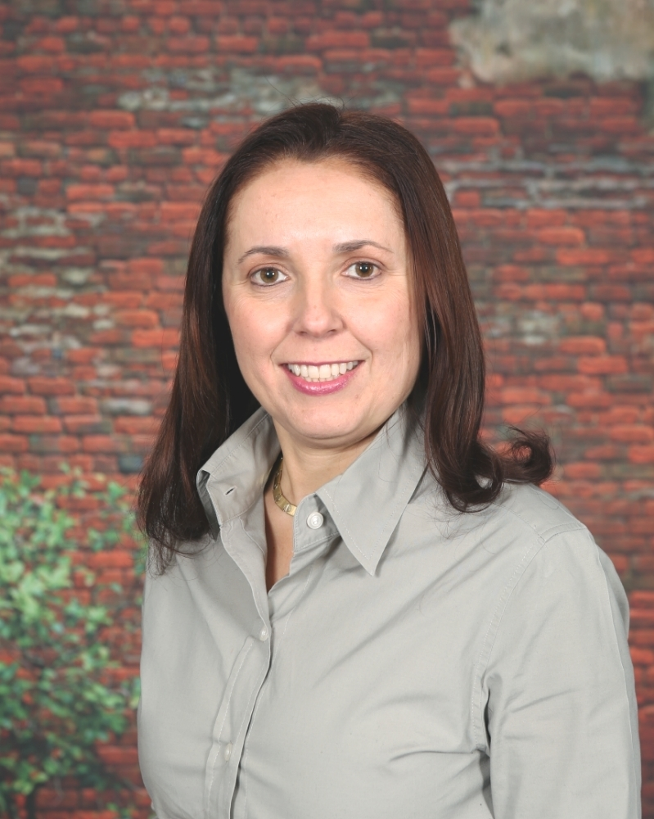
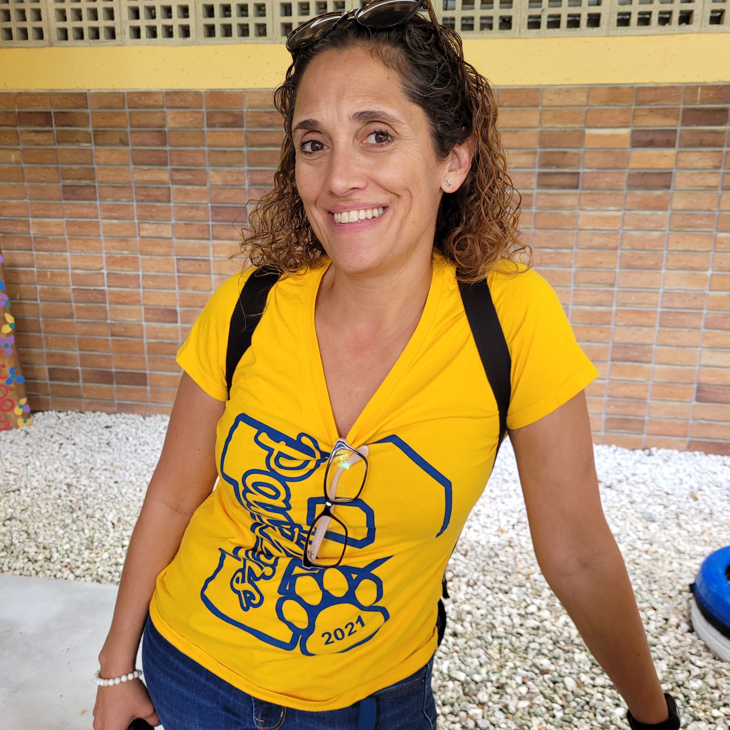
MEET your school TEAM
Wendy Hernandez
Principal
Maricarmen Abreu
Assistant Principal
Denise De La Milera
CLS
25
Notes:
Allow school staff to greet parents/families. Encourage school staff to insert pictures so parents and families may be able to view this presentation later if archived, and for easier identification of relevant staff.

Slide 26
What Questions do you have?
26
Notes:
Address question and concerns from participants. Inform how the school will respond to all questions/concerns posed/posted on the post-it note question board during the meeting if time does not permit.

Slide 27
Comments/Feedback
27
Notes:
Save attendance documents, comments, and feedback that were submitted via the meeting.

Slide 28
THANK YOU FOR BEING A MEMBER OF OUR TITLE I FAMILY!
28
Notes:
Thank you for your continued support of the Title I Schoolwide Program.

