Slide 1
Welcome to
Sunset Park Elementary
Pre-Kindergarten
Parent Orientation

Slide 2
Administration
Mrs. Wendy Hernandez
whernandez@dadeschools.net
Mrs. Maricarmen Abreu
mariabreu@dadeschools.net

Slide 3
Pre-Kindergarten Team
Mrs. Melissa Bayuelo, Teacher
Mbayuelo@dadeschools.net
Mrs. Magaly Crespo, Paraprofessional
Mrs. Jaclyn Tojdowski, Teacher
jcento@dadeschools.net
Miss Melissa Montoya, Paraprofessional

Slide 4
School Information
Arrival
8:10
Tardy
Late Pass
Dismissal
1:50
Absence
Bring Excused Note
Before/After Care
Uniform
Mandatory Uniforms
Community Involvement
Register to become a School Volunteer
Lunch
Free
Free/Reduced Lunch Application

Slide 5
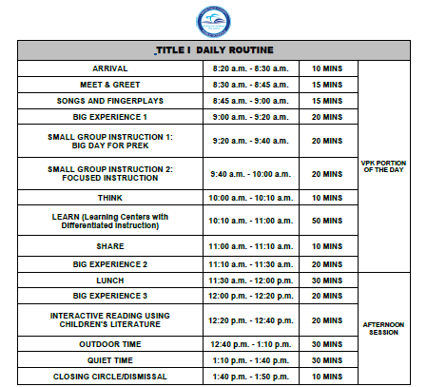
Pre-K Daily Schedule

Slide 6
A Day in Pre-K
1
Arrival Time Students should be in school every day between 8:10-8:20. Tardiness disrupts your child’s learning activities and structured schedule.
2
Sign In/Journaling Students will practice writing their name and will engage in a drawing/writing activity in their primary journal.

Slide 7
A Day in Pre-K
3
Meet & Greet Students will sing morning songs, engage in attendance, calendar activities, discuss weather, and develop their oral language skills.
4
Think/Learn/Share Students will work in the learning centers and use their creativity while developing their imagination, dexterity, and physical, cognitive and emotional strengths. During Think, children indicate what they plan to do at the center of their choice. During Learn Time, children will carry out their initial and subsequent plans. During Share, all children will be engaged in conversation regarding their center time experiences. Children will display and /or discuss what they did.

Slide 8
A Day in Pre-K
5
Big Experience 1 Big Experience is a large group time activity The central organizing features of the Big Day for Pre-K Curriculum are the Big Experiences-Circle Time and Story Time lessons-that occur three times each day. The learning domains are spiraled throughout the three Big Experiences.
6
Phonological Awareness Students will engage in whole group activities that develop listening skills, pre-reading skills and language development as well as letter and sound recognition through the use of songs and fingerplays.

Slide 9
A Day in Pre-K
7
Big Experience 2 During read aloud, teachers use the dialogic reading approach that encourages conversational interactions and gives children opportunities to experiment with and explore language.
8
Small Group Instruction Small Group Instruction 1 targets essential literacy and mathematical skills allowing teachers to provide focused instruction, guidance, and feedback in key skills. Small group instruction 2 are activities introduced by the teacher based on children’s interests, observations of children, introduction of new materials, basic skills, themes and/or holiday related activities.

Slide 10
A Day in Pre-K
9
Big Experience 3 The Big Experiences engage children in playful, intentional learning that integrates social-emotional, academic, and physical development to anchor, build, and extend learning.
10
Lunch Students will eat lunch in the cafeteria. The Paraprofessional will assist in opening any items that students may need assistance with.

Slide 11
A Day in Pre-K
11
Shared Reading Students will be introduced to developmentally appropriate literature and develop their reading and concepts of print skills.
12
Outside Time Students engage in outdoor to develop their large muscle skills and coordination.

Slide 12
A Day in Pre-K
13
Quiet Time Student will rest or read a book independently.
14
Closing Circle Closing circle provides a smooth transition from school to home and gives children and adults a chance to review the day’s activities and discuss plans for the next day.

Slide 13
A Day in Pre-K
15
Dismissal Time Students will be dismissed to Afterschool Care Leaders or Parents. Students must be picked up on time. Teachers use this time to plan and prepare materials for activities and/or intervention strategies for the following day(s).

Slide 14
Attendance
Attendance Policy
Mandated by the State of Florida
Monthly Attendance
Sign/Date

Slide 15
Classroom Information
Communication
ClassDojo
Email
Home Learning
Take Home Folder Daily
Home Learning Packets given on Monday’s and due on Friday’s
VPK Assessment
3x a year
Parent Conference
3x a year and/or as needed
Sign-Up Sheet
Sweater
Water Bottles

Slide 16
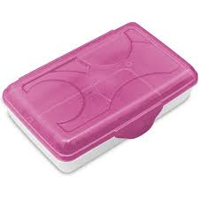
School Supplies
LARGE BACKPACK/ NO WHEELS SMALL BLANKET 1 DURABLE 2 POCKET FOLDER ERASERS PLAY DOUGH PENCIL BOX SCISSORS PENCILS | CRAYONS GLUE STICKS 1 BOTTLE OF WHITE GLUE 2 PRIMARY JOURNALS (half page ruled) UNIFORMS TOPS: Solid White, Navy Blue, School T-Shirt BOTTOMS: Navy/Khaki Pants, skirts/skorts, shorts *Extra change of clothes in a labeled Ziploc bag.
WISH LIST
Baby Wipes
Disinfectant Wipes
Disinfectant Spray
Copy Paper
Box of Tissues
Hand Sanitizer
Liquid Soap
Paper Towel Roll

Slide 17
Educational Goals
Language Arts
Write First/Last Name
Letter Names
Letter Sounds
Rhyming Words
Syllables
Compound Words
Blending Sounds
Deleting Sounds
Word Families
Sight Words
Read/Write Simple Sentences
Mathematics
Count to 30
Write Number to 20
Position Words
Patterns
Ordinal Numbers (Identification)
Comparing Quantities
Addition
Subtraction

Slide 18
Questions and Answers Thank you for being present today! ☺

